Slide 1
ASP.NET – Part II
Data Binding, Data Sources, GridView, FormView, DetailsView, DataList, Repeater, ListView, Pager
Ventsislav Popov
Crossroad Ltd.
www.crossroad.bg

Slide 2
Table of Contents
Data binding mechanism
Overview of Data-bound Web Server Controls
Using Templates in Data-bound Controls
Data Source Controls

Slide 3
What is Data Binding
The process of filling data into a control from a data source
Controls which support data binding have
A property DataSource
A method DataBind()
To bind a control we have to
set the property DataSource
call the method DataBind()

Slide 4
When Data is Binding Done
Data is static:
Binding can be done when the control is created
Data is obtained dynamically
In Page_Load() or Page_PreRender()
In an event handler

Slide 5
What Does Data Binding Need?
Every class deriving from IEnumerable (IEnumerable<T> derives from IEnumerable)
Arrays, e.g. Town[]
Lists, e.g. List<Town>
Custom classes
Data Sources Controls
The DataTable and DataSet classes

Slide 6
List-bound Controls
Controls that can be bound to a data source
Abstract class ListControl is base class for all list controls
BulletedList
CheckBoxList
RadioButtonList
DropDownList
ListBox

Slide 7
List-bound Controls – Common Properties
Connect to a data source using the properties:
DataSource – sets the data source
DataMember – optionally indicates the object inside the data source (e.g. table in a DataSet)
When displaying values, the following are used:
DataTextField – sets the column (property) which will be displayed
DataValueField – sets the column that will provide the value for the control

Slide 8
BulletedList
Displays data in the form of a list
Ordered or unordered
BulletStyle – Circle, Disk, LowerRoman…
BulletImageUrl
DisplayMode
Text, HyperLink, LinkButton
FirstBulletNumber

Slide 9
CheckBoxList
Displays data as a list of check boxes
RepeatColumns – the number of columns displayed
RepeatDirection
Vertical, Horizontal
RepeatLayout
Table, Flow

Slide 10
RadioButtonList
Displays data as a list of RadioButton controls
RepeatColumns – the number of columns displayed
RepeatDirection
Vertical, Horizontal
RepeatLayout
Table, Flow
Use the Items property to access its elements

Slide 11
DropDownList & ListBox
DropDownList
Single-selection drop-down list box.
Shows only the selected item in a box
ListBox
Allows single or multiple item selection
Rows – the number of rows displayed in the ListBox control
SelectionMode
Single, Multiple

Slide 12
List-bound Controls
Live Demo

Slide 13
Complex Data-bound Controls
Combine other ASP.NET Web controls into a single layout.
Enable you to customize the layout of the control using templates
Provide a convenient model for handling and canceling events.

Slide 14
Types of Complex Data-bound Controls
GridView
Displays data as a table and provides the capability to sort columns
DetailsView
Renders a single record at a time
Often used in master-detail scenarios
Does not support templates
FormView
Similar to DetailsView, but supports templates

Slide 15
Types of Complex Data-bound Controls
Repeater
Renders a read-only list from a set of records
You create the layout using templates
DataList
Renders data as table
Data modification should be explicitly defined
ListView
Similar to the DataList and Repeater, but implicitly supports edit, insert, and delete

Slide 16
GridView
Displays data in the form of a table
Consists of columns, header and footer
Columns can be auto generated according to the data source or set explicitly
Supports paging, sorting, selecting, editing and deleting
Easy to change the appearance and to personalize

Slide 17
GridView Columns
Set AutoGenerateColumns to false to customize the columns in the GridView
Name
Description
BoundField
Renders a text column – data comes from the data source
ButtonField
Renders a column with buttons (Button, ImageButton или Link)
CheckBoxField
Renders a column with CheckBox for boolean data
CommandField
Renders a column for the commands (edit,delete …)
HyperLinkField
Renders a column with links in it
ImageField
Renders a column with an image. The URL is in the data source
TemplateField
Renders a column based on an HTML Template

Slide 18
Binding And Customizing GridView
Live Demo

Slide 19
Data-binding Syntax
ASP.NET offers declarative syntax for data-binding
<%# expression %>
Evaluated when the DataBinding event of the corresponding control is fired for each item(record, row) in the data source
The DataBinder class is used internally to retrieve the value in a column

Slide 20
Data-binding Syntax-Example
// Binding to a property
Customer: <%# custID %>
// Binding to a collection
Orders: <asp:ListBox id="ListCountries"
datasource='<%# myArray %>' runat="server">
// Binding to an expression
Contact: <%# ( customer.FirstName + " " + customer.LastName ) %>
// Binding to the output of a method
Outstanding Balance: <%# GetBalance(custID) %>

Slide 21
The DataBind(…)Method
DataBind(…) is a method that Page and all server controls have
DataBind(…) is called in a cascading order for all controls in the parent control
Starts the evaluation of all the <%#...%> expressions
Frequently DataBind(…) is called in the Page_Load or Page_Prerender event

Slide 22
How DataBind(…)Works
Although similar to <%Response.Write…%> its behavior is different
Response.Write(…) is evaluated (calculated) when the page is compiled
The ASP.NET syntax is evaluated when the DataBind(…)method is called
If the method is never called the expression <%#... %> is not displayed

Slide 23
Templates
The GridView, Repeater and FormView offer rich customization capabilities by utilizing templates
Provide a way to display data
Provide a way to format the appearance of data
The current DataRowView element is accessible through the Container.DataItem property

Slide 24
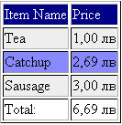
Templates - Example
HeaderTemplate
ItemTemplate
AlternatingItemTemplate
FooterTemplate

Slide 25
Getting The Current Item
ASP.NET offers two methods to get each separate item from a collection (DataTable, Array…) to which a control is bound:
Container.DataItem – the standard way
DataBinder.Eval – a static method using reflection
Slower than Container.DataItem

Slide 26
Container.DataItem
Access to the currently binding item
It must be explicitly cast to the type of the item
Otherwise it is an object
The current item is of type:
DataRowView if the datasource is a DataTable
An instance of a type if the control is bound to a collection of the given type

Slide 27
DataBinder and DataBinder.Eval
DataBinder is a class aimed at the Rapid Application Developers (RAD)
Provides means to easily access the current DataItem
DataBinder.Eval - evaluates late-bound data-binding expressions
Optionally formats the result as a string
string DataBinder.Eval ( object container, string expression, string format )

Slide 28
DataBinder.Eval - Parameters
Container - the object reference against which the expression is evaluated
Usually Container.DataItem
Expression – the path to a public property of the Container
Format (optional) – a formatting string to apply
You can also use Eval(string expression, string format )
It assumes Container.DataItem

Slide 29
DataBinder.Eval vs Container.DataItem
// Using Container.DataItem
<%# String.Format("{0:c}",
((DataRowView) Container.DataItem)["IntegerValue"])%>
// Using DataBinder.Eval
<%# DataBinder.Eval(Container.DataItem, "IntegerValue", "{0:c}") %>
// Using Eval
<%# Eval("IntegerValue", "{0:c}") %>
Notes:
Бележки на автора:
http://www.c-sharpcorner.com/Code/2003/June/DataGridHyperLinkColumn.asp
<asp:DataGrid id="DataGrid1" AutoGenerateColumns="False" runat="server">
<Columns>
<asp:TemplateColumn HeaderText="Link">
<ItemTemplate>
<asp:HyperLink Runat =server
NavigateUrl ='<%#GetURL(DataBinder.Eval(Container.DataItem, "Link"))%>' >
<%#DataBinder.Eval(Container.DataItem, "Link")%>
</asp:HyperLink>
</ItemTemplate>
</asp:TemplateColumn>
</asp:DataGrid>

Slide 30
FormView
Template version of DetailsView
Doesn’t use predefined view
Requires the developer to define the view by using templates
Doesn’t have commands
It has mode
You can use many controls for the templates - DropDownList, Calendar , etc.

Slide 31
FormView
You are responsible to define all the templates
ItemTemplate, EditItemTemplate, InsertItemTemplate
Use the Eval() method to accomplish a read-only binding
Use the Bind() method for a real 2-way binding

Slide 32
Repeater
GridView doesn’t give full control
Uses HTML tables (<table>)
The Repeater control is the most flexible one
You write the HTML visualization code yourself
Useful when you want to implement a non standard visualization of read-only data
The output code is easy to read

Slide 33
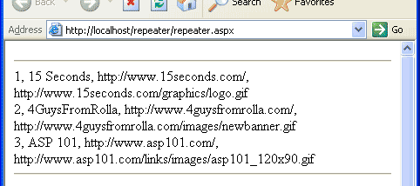
Repeater – Example
<asp:Repeater id="myRepeaterPlain" runat="server">
<ItemTemplate>
<%# DataBinder.Eval(Container.DataItem, "Id") %>,
<%# DataBinder.Eval(Container.DataItem, "Name") %>,
<%# DataBinder.Eval(Container.DataItem, "URL") %>,
<%# DataBinder.Eval(Container.DataItem, "Image") %>
<br />
</ItemTemplate>
</asp:Repeater>
Notes:
Бележки на автора:
Пример със изброяване на всеки ред от базата. Елементите на всеки ред се отделят със запетая. Всеки ред от базата от данни е на нов ред (<br />).

Slide 34

Repeater – Example (2)
<asp:Repeater id="myRepeaterUL" runat="server">
<HeaderTemplate>
<ul>
</HeaderTemplate>
<ItemTemplate>
<li>
<a href="<%#DataBinder.Eval(
Container.DataItem,"URL") %>">
<%# DataBinder.Eval(
Container.DataItem, "Name") %>
</a>
</li>
</ItemTemplate>
<FooterTemplate>
</ul>
</FooterTemplate>
</asp:Repeater>
Notes:
Бележки на автора:
Пример със използване на списък и хипервръзки.

Slide 35
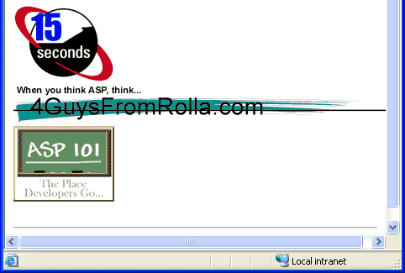
Repeater – Example (3)
<asp:Repeater id="myRepeaterImage" runat="server">
<ItemTemplate>
<a href="<%# DataBinder.Eval(Container.DataItem,
"URL") %>">
<img src="<%#DataBinder.Eval(
Container.DataItem, "Image") %>"
border="0"
alt="<%# DataBinder.Eval(
Container.DataItem, "Name") %>"/>
</a>
</ItemTemplate>
</asp:Repeater>
Notes:
Бележки на автора:
Пример със използване на картинки.

Slide 36
Using Repeater And Templates
Live Demo

Slide 37
DataPager
DataPager is that it gives you a single, consistent way to use paging with a variety of controls
The ListView is the only control that supports the DataPager
Pager Fields
NextPreviousPagerField
NumericPagerField
TemplatePagerField

Slide 38
DataPager
Live Demo

Slide 39
Data Source Controls
There are special controls that take care of data binding details – Data Source Controls
SqlDataSource, ObjectDataSource, XmlDataSource, etc…
They are an abstraction over the data source
DataBound controls are associated to a Data Source Control through the property DataSourceID

Slide 40
SqlDataSource
Provides connection to a database (MS SQL, Oracle etc.)
Data is manipulated by using commands
Select, Update, Insert and Delete
Commands can be either SQL queries or the name of a stored procedure
Uses DataSet by default
The property DataSourceMode sets whether to use DataSet or DataReader

Slide 41
Using SqlDataSource
Live Demo

Slide 42
LinqDataSource
The LinqDataSource is designed to bind against a LINQ enabled data model
Ways to connect a data control to a wide variety of data sources
Database data
Data-source classes
And in-memory collections
You can connect to any kind of data collection that is public

Slide 43
LinqDataSource - Benefits
It leverages the flexibility that LINQ based ORMs provide
The LinqDataSource control automatically create the commands for interacting with the data

Slide 44
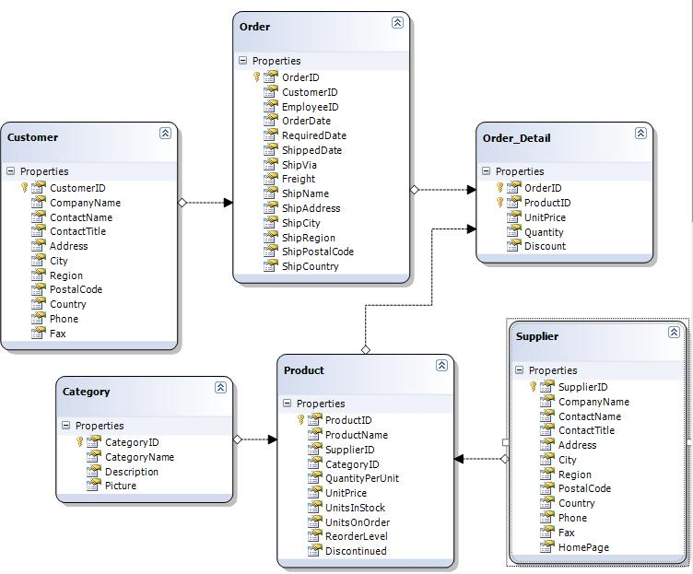
LinqDataSource - Example
Define our Data Model
Creating a basic product listing
<div>
<asp:GridView ID="GridViewProducts" runat="server">
</asp:GridView>
</div>
Notes:
ObjectDataSource..::.TypeName Property
Gets or sets the name of the class that the ObjectDataSource object represents.
ObjectDataSource..::.DataObjectTypeName Property
Gets or sets the name of a class that the ObjectDataSource control uses for a parameter in an update, insert, or delete data operation, instead of passing individual values from the data-bound control.

Slide 45
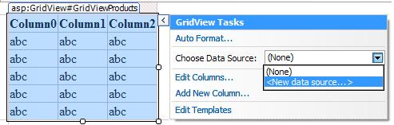
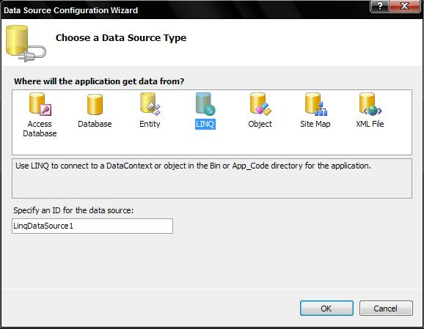
LinqDataSource – Example (2)
Bind the GridView to our data model
Select the new "LINQ" option in the dialog box
Notes:
ObjectDataSource..::.TypeName Property
Gets or sets the name of the class that the ObjectDataSource object represents.
ObjectDataSource..::.DataObjectTypeName Property
Gets or sets the name of a class that the ObjectDataSource control uses for a parameter in an update, insert, or delete data operation, instead of passing individual values from the data-bound control.

Slide 46
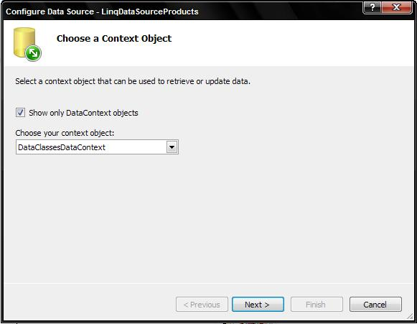
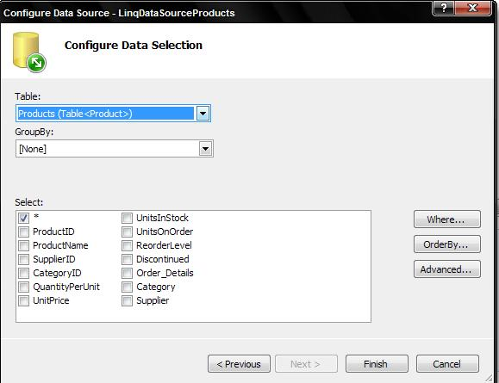
LinqDataSource – Example (3)
Designer will then display the available LINQ to SQL DataContext classes
Choose the table and click finish
Notes:
ObjectDataSource..::.TypeName Property
Gets or sets the name of the class that the ObjectDataSource object represents.
ObjectDataSource..::.DataObjectTypeName Property
Gets or sets the name of a class that the ObjectDataSource control uses for a parameter in an update, insert, or delete data operation, instead of passing individual values from the data-bound control.

Slide 47
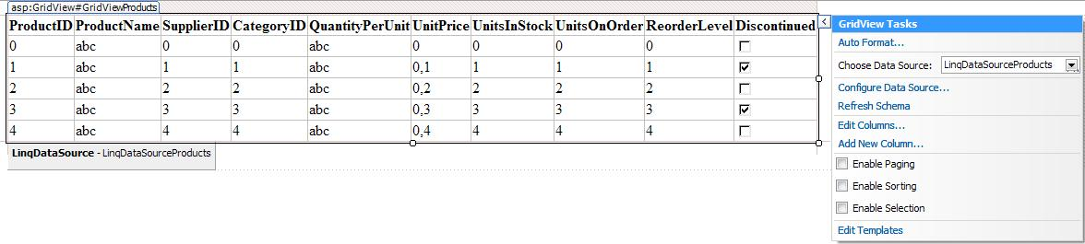
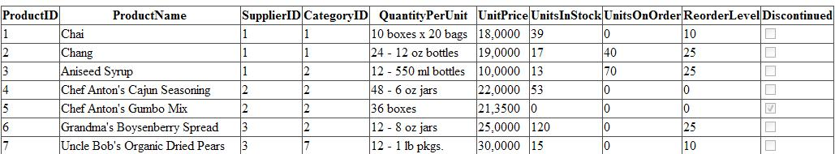
LinqDataSource – Example (4)
The result ( in VS)
The result in browser
Notes:
ObjectDataSource..::.TypeName Property
Gets or sets the name of the class that the ObjectDataSource object represents.
ObjectDataSource..::.DataObjectTypeName Property
Gets or sets the name of a class that the ObjectDataSource control uses for a parameter in an update, insert, or delete data operation, instead of passing individual values from the data-bound control.

Slide 48
Using LinqDataSource
Live Demo

Slide 49
ObjectDataSource
Enables data-binding of a control to an object instead of directly to a database
Needs a middle-tier business object
Data manipulation is based on methods
TypeName – name of the business object
Select, Update, Insert and Delete
DataObjectTypeName – a class passed as a parameter in Update, Insert, Delete

Slide 50
Using ObjectDataSource
Live Demo

Slide 51
Other Data Sources
Hierarchical
XmlDataSource
Establishes a connection to an Xml source of data (files, documents)
DataFile, TranformFile, XPath
SiteMapDataSource
Access
AccessDataSource
Derives from SqlDataSource
DataFile

Slide 52
Higlights

Slide 53
ASP.NET – Part II

Slide 54
References
“ASP.NET Data-Binding” (presentation) – Iliyan Murdanliev

